Slide 2
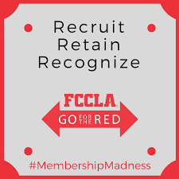

Slide 3
Go For the Red, FCCLA’s annual membership campaign, provides incentives for members and chapters working to increase membership. Go For the Red empowers students to recruit, retain, and recognize members.

Slide 4
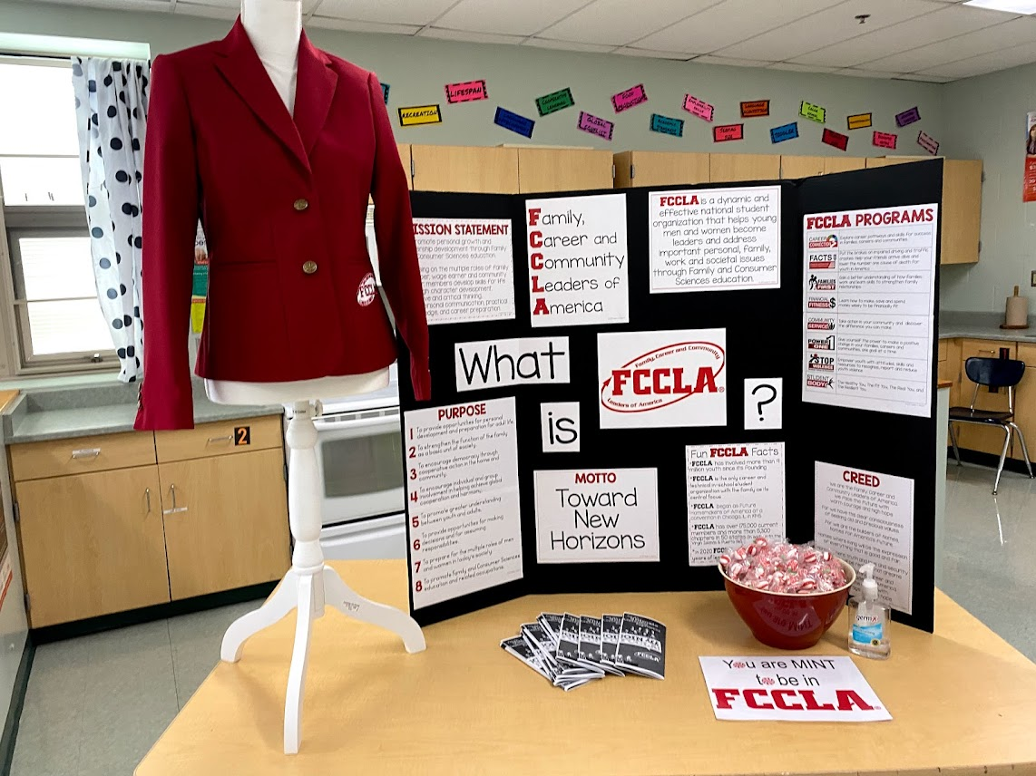
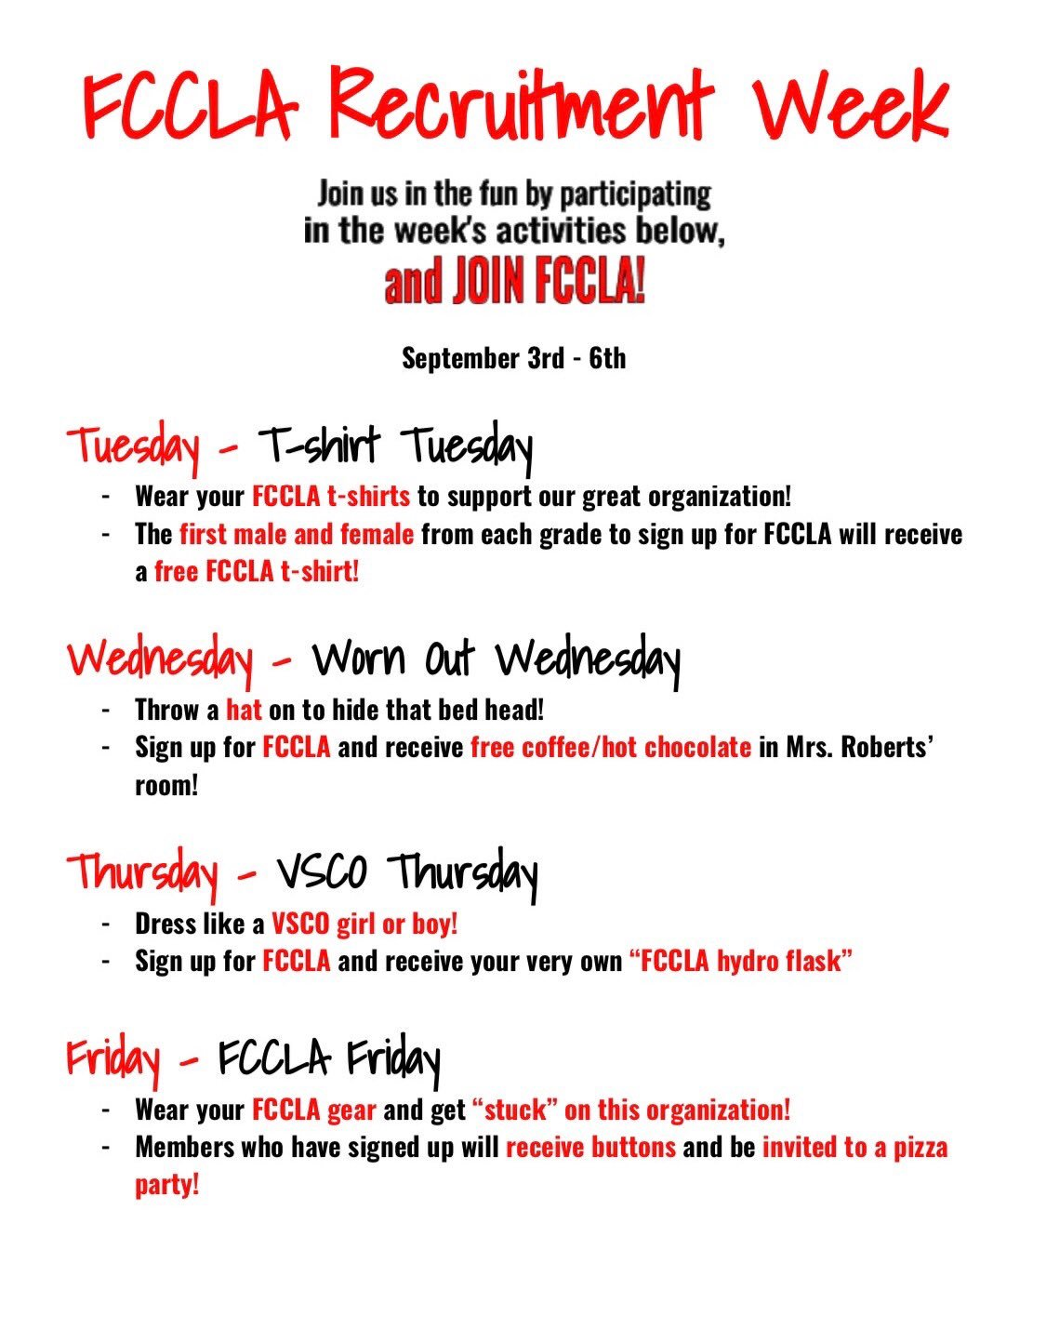
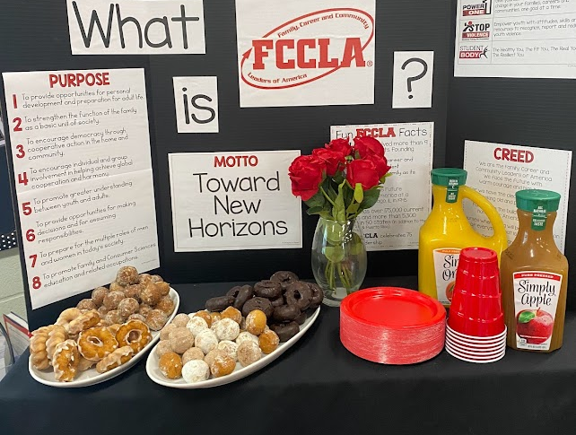
Recruit!
Food
Fun
Members
Incentives
School Activities
Middle Schoolers/Freshmen

Slide 5
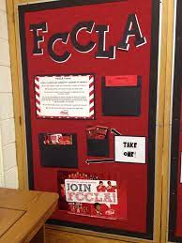
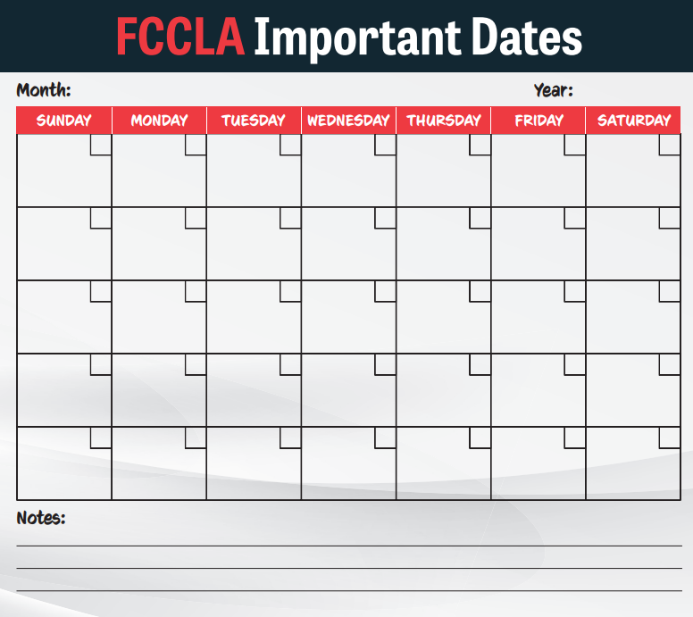
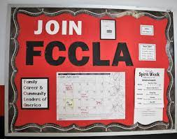
Retain!
Value Members
Flexibility with Scheduling
Plan ahead and Publicize
Communicate

Slide 6
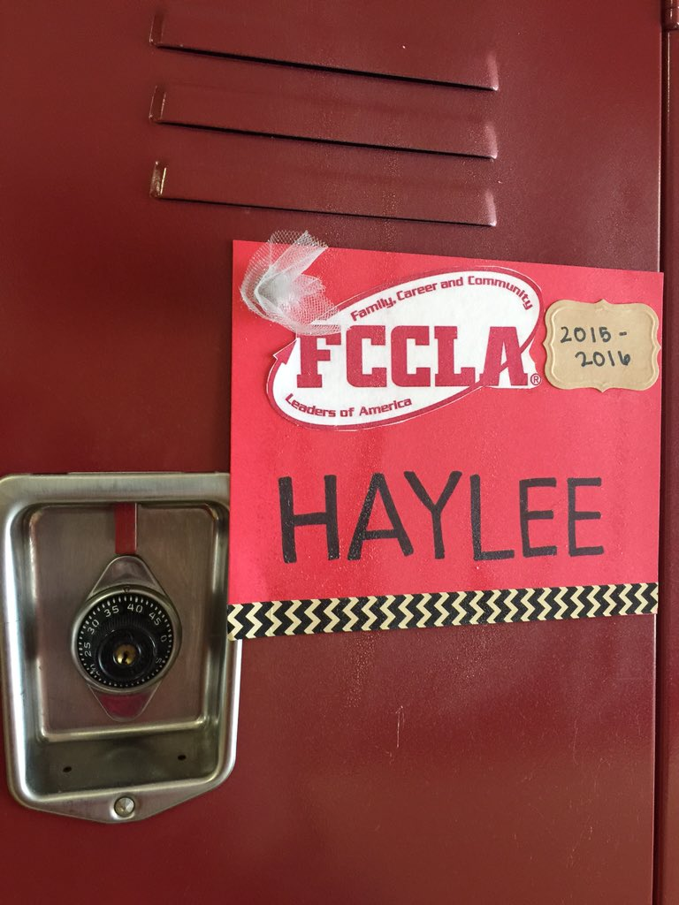
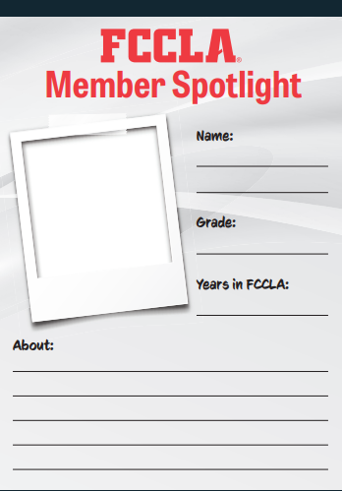
Recognize!
Chapter Apparel
Locker Signs
Member of the Week/Month!
Showcase Past STAR Events during Meetings/Classes

Slide 7
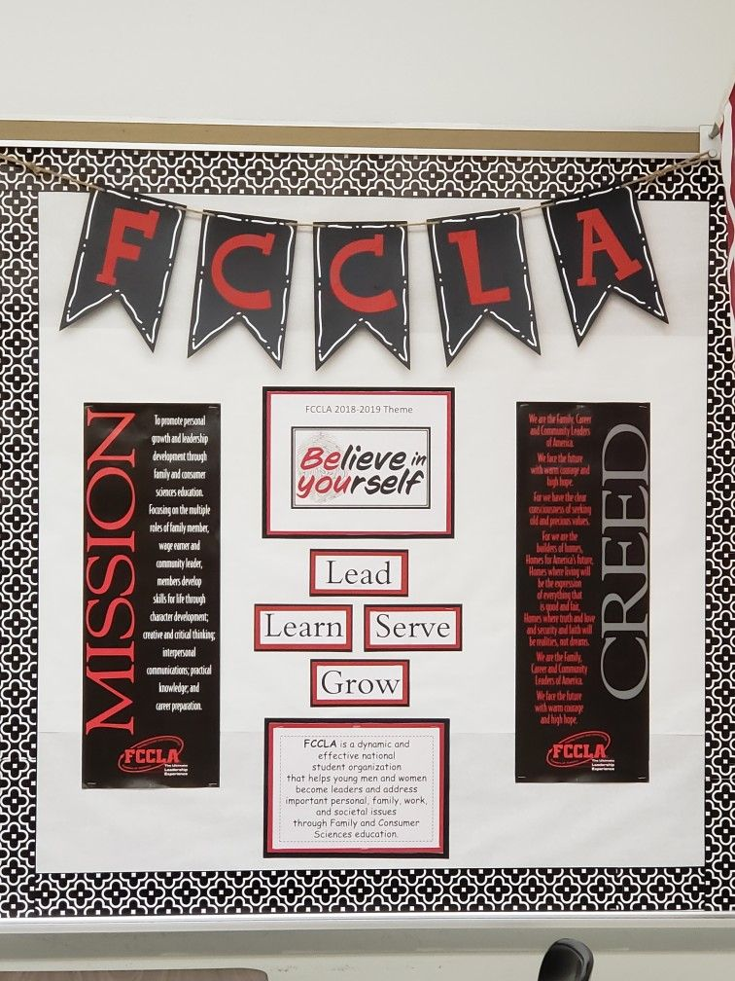
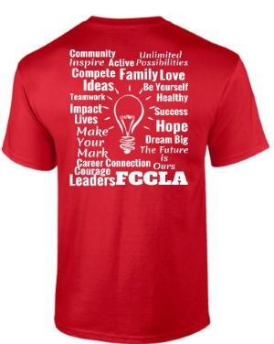
Visability
Display the emblem, creed, and purposes.
Create an information display or bulletin board
Chapter Shirts
WEAR RED and FCCLA!
Use Social Media

Slide 8
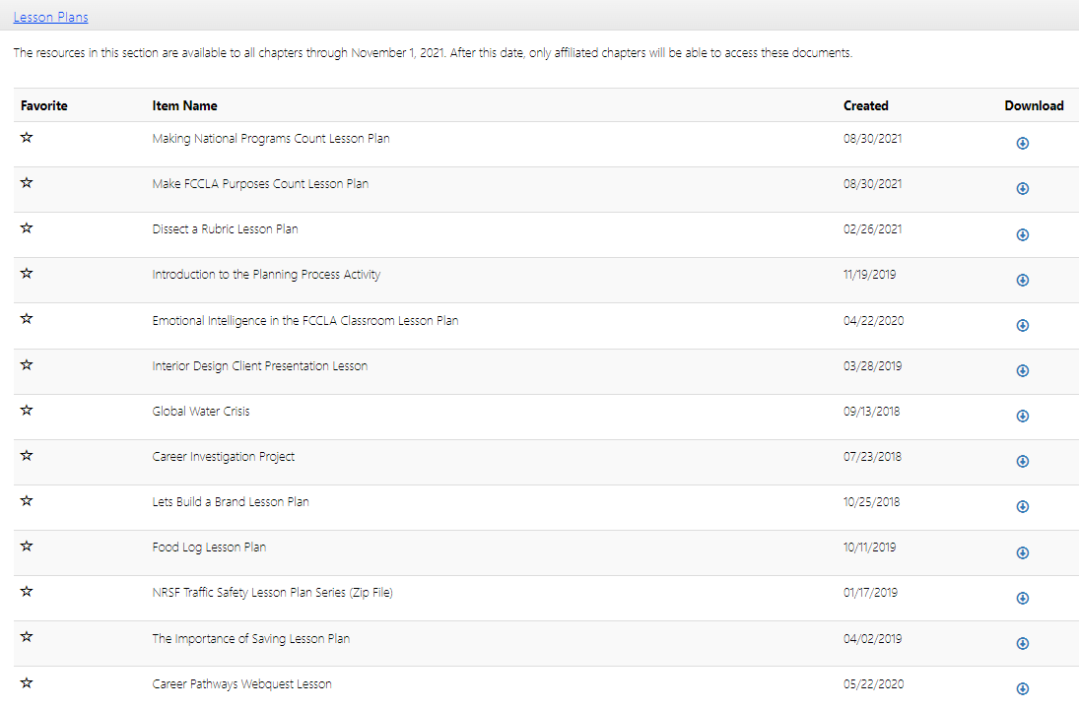
Integrate!
Step 1
Webquest
Room Search
Bitmoji Classroom
Bingo
Digital Interactive Games
Teen Times
FCCLA Facts Games
Scavenger Hunt
FCCLA Fridays
National Programs

Slide 9
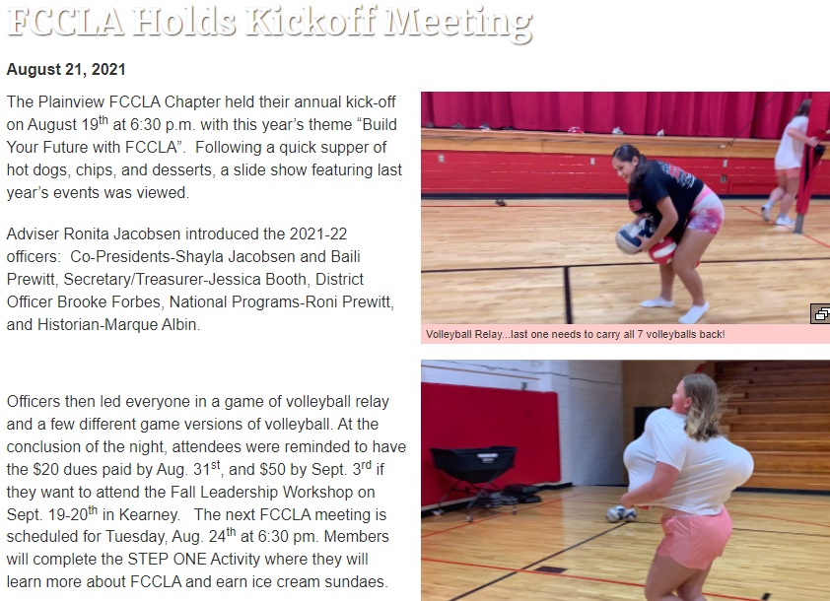
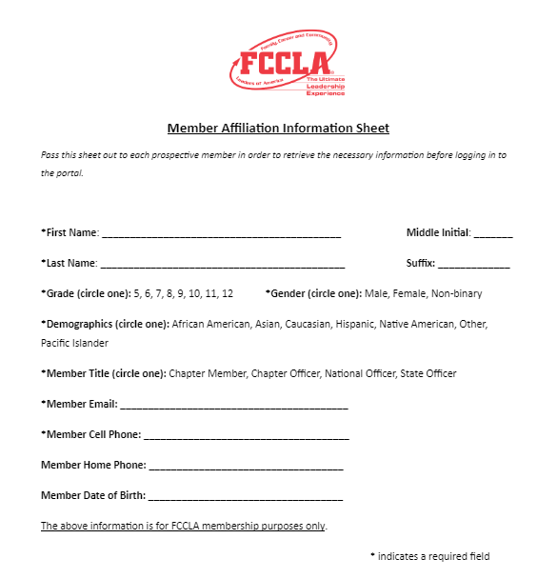
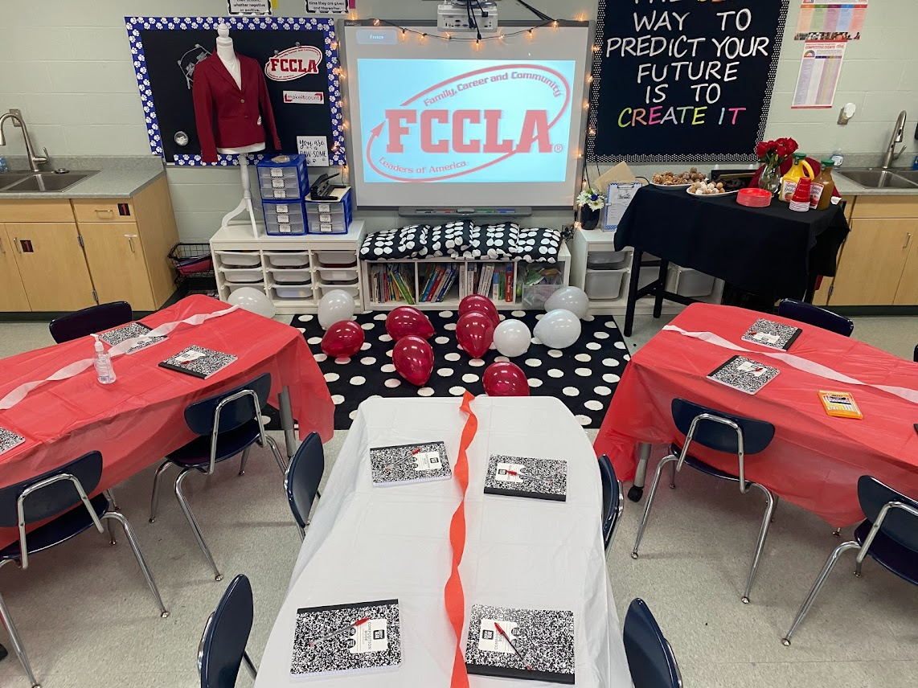
Kickoff Meetings
Open House
Kick-Off Party
Recruitment Week
Membership Forms-EASY!
Affiliation

Slide 10
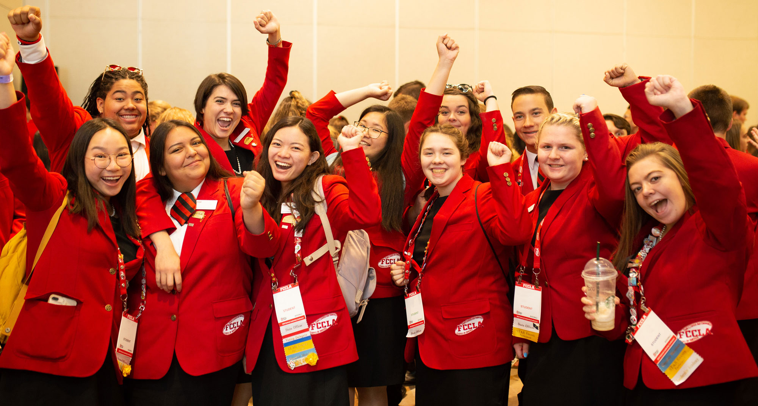
Final Thoughts….
Be visible!
Remember to recruit younger students!
Make it easy to join!
Get the guys involved too!
Scheduling Flexibility!
Integrate!
Have fun!!

