Slide 1
2019 AREA FALL CONFERENCE

Slide 2
Opening Session Flag Ceremony

Slide 3
OPENING CEREMONY
President: Our mission is to promote personal growth and leadership development through Family and Consumer Sciences Education.
Officers: Focusing on the multiple roles of family member, wage earner and community leader, members develop skills for life through character development, creative and critical thinking, interpersonal communication, practical knowledge and career preparation.

Slide 4
Members: As we work toward the accomplishment of our goals, we learn cooperation, take responsibility, develop leadership and give service.

Slide 5
We are the Family, Career and Community Leaders of America.
We face the future with warm courage and high hope.
For we have the clear consciousness of seeking old and precious values.
For we are the builders of homes,
Homes for America’s future,
Homes where living will be the expression of everything that is good and fair,
Homes where truth and love and security and faith will be realities, not dreams.
We are the Family, Career and Community Leaders of America.
We face the future with warm courage and high hope.
CREED

Slide 6
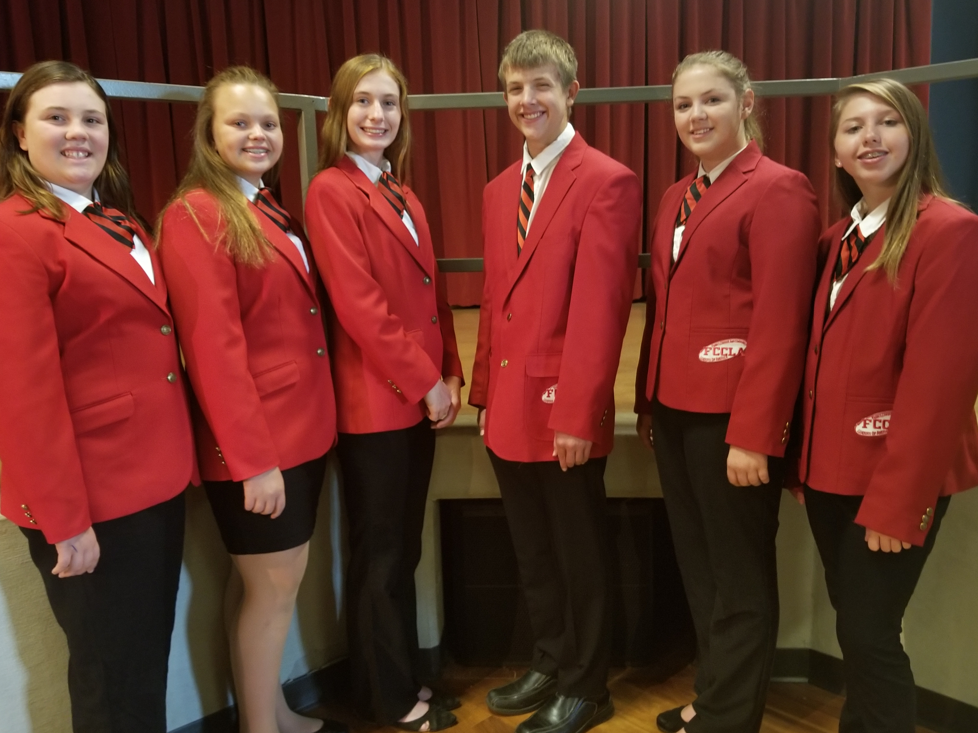
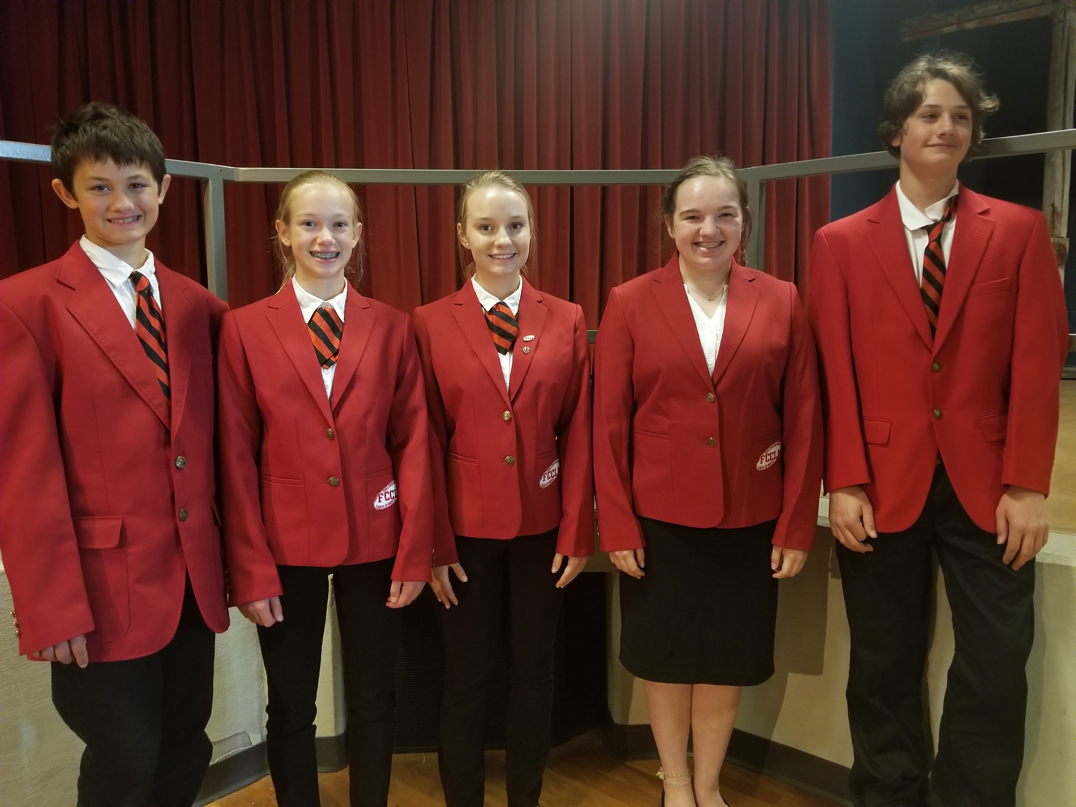
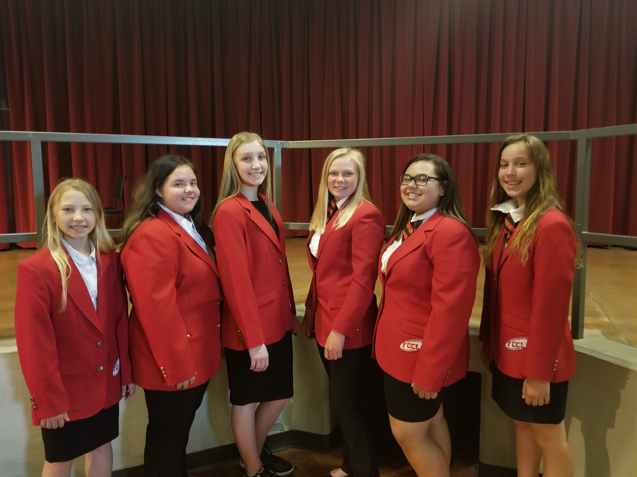
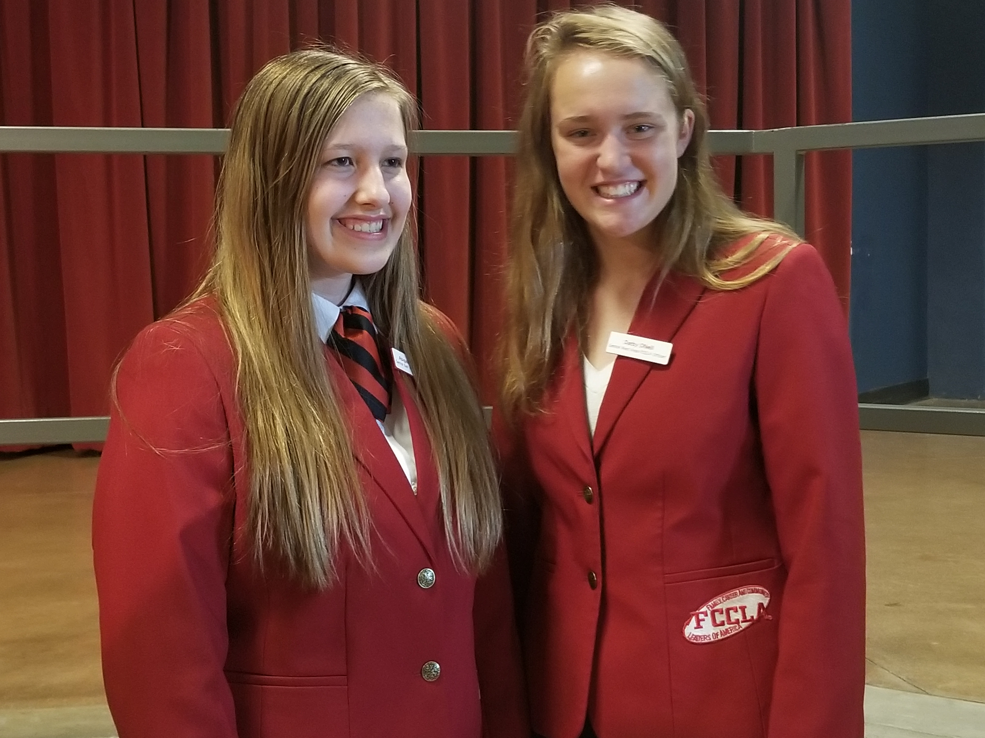
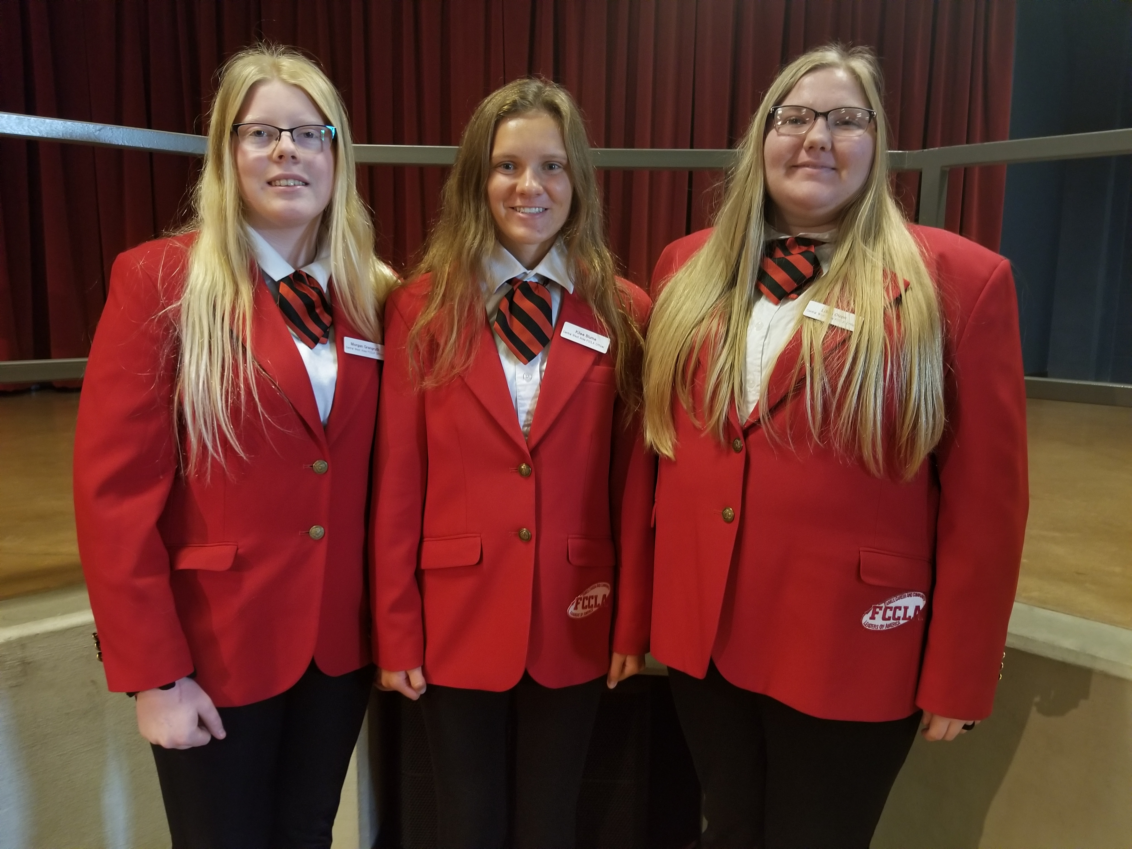
Meet your Area FCCLA Officer TeamS!
SouthWest Area Officers
SouthEast Area Officers
Northern Area Officers
Central East Area Officers
Central West Area Officers

Slide 7
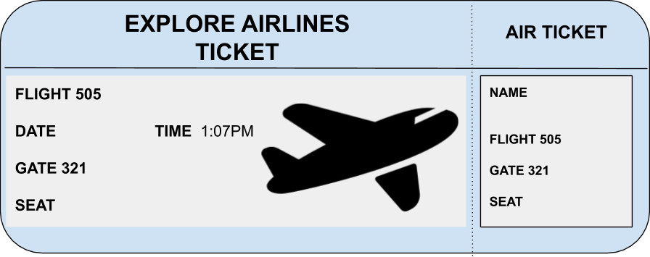
State Theme

Slide 8
FCCLA - Find a World of Possibilities
Flight Number | City | Flight Name | Airport | Airline | Details
637 | Chicago | Procrastination | ORD | Southwest | Delayed
755 | Las Vegas | Bad Behavior | LAS | Allegiant | Cancelled
934 | Orlando | Organization | MCO | Delta | On Time
289 | Winnipeg | Honesty and Integrity | YWG | United | Delayed
222 | Paris | Planning Skills | CDG | Air France | On Time
799 | Berlin | Time Management | TXL | Emirates | On Time
861 | Hong Kong | Networking | HHP | China Eastern | On Time
555 | Anaheim | Leadership | LAX | American | On Time
438 | Fairbanks | Accountability | FAI | Alaskan | On Time

Slide 9
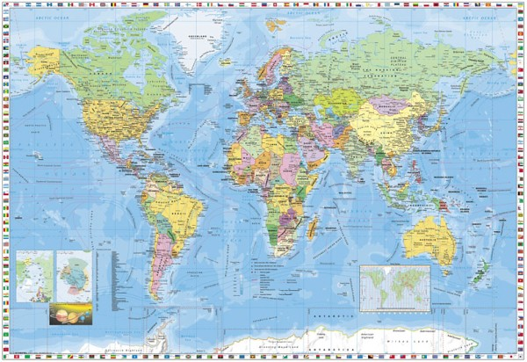
find a
WORLD OF
possibilities

Slide 10
2019-2020 State Theme
Our state theme goals…..
1 –Travel into Career Pathways
2-Unpack your skills for success
3-Purchase your ticket toward new horizons

Slide 11
WELCOME STATE OFFICER

Slide 12
GUESTS
STATE OFFICERS
PROJECT ANNOUNCEMENTS

Slide 13
ROLL CALL OF CHAPTERS

Slide 14
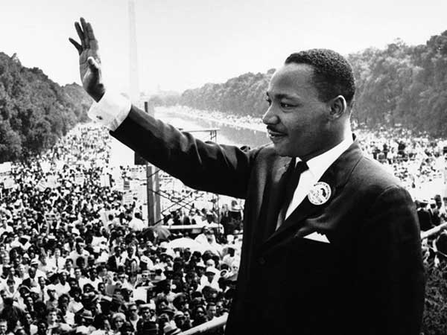
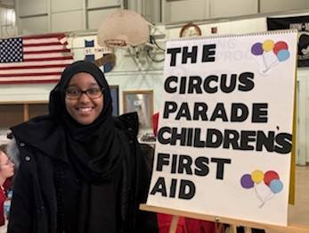
GET INTO Service Projects FOR 2019-2020
FCCLA Chapters honor Military and Veterans for 9-11 Day in September.
Martin Luther King Day Service efforts will focus on reducing poverty and increasing financial literacy and Lead4Change food shelf projects.
Global Youth Service Day 2020 in April and celebrating service at State FCCLA Conference.

Slide 15
INCREASE CHAPTER MEMBERSHIP

Slide 16
AWARDS
National Program Awards
New Members award
Chapter Spirit Award
Ultimate Leader Award

Slide 17
MINNESOTA STAR EVENT ENTRY DEADLINE
JANUARY 6

Slide 18
Stand if the ANSWER is TRUE Sit if the ANSWER is FALSE
AUDIENCE PARTICIPATION

Slide 19
SPEAKER

Slide 20
ANNOUNCEMENTS

Slide 21
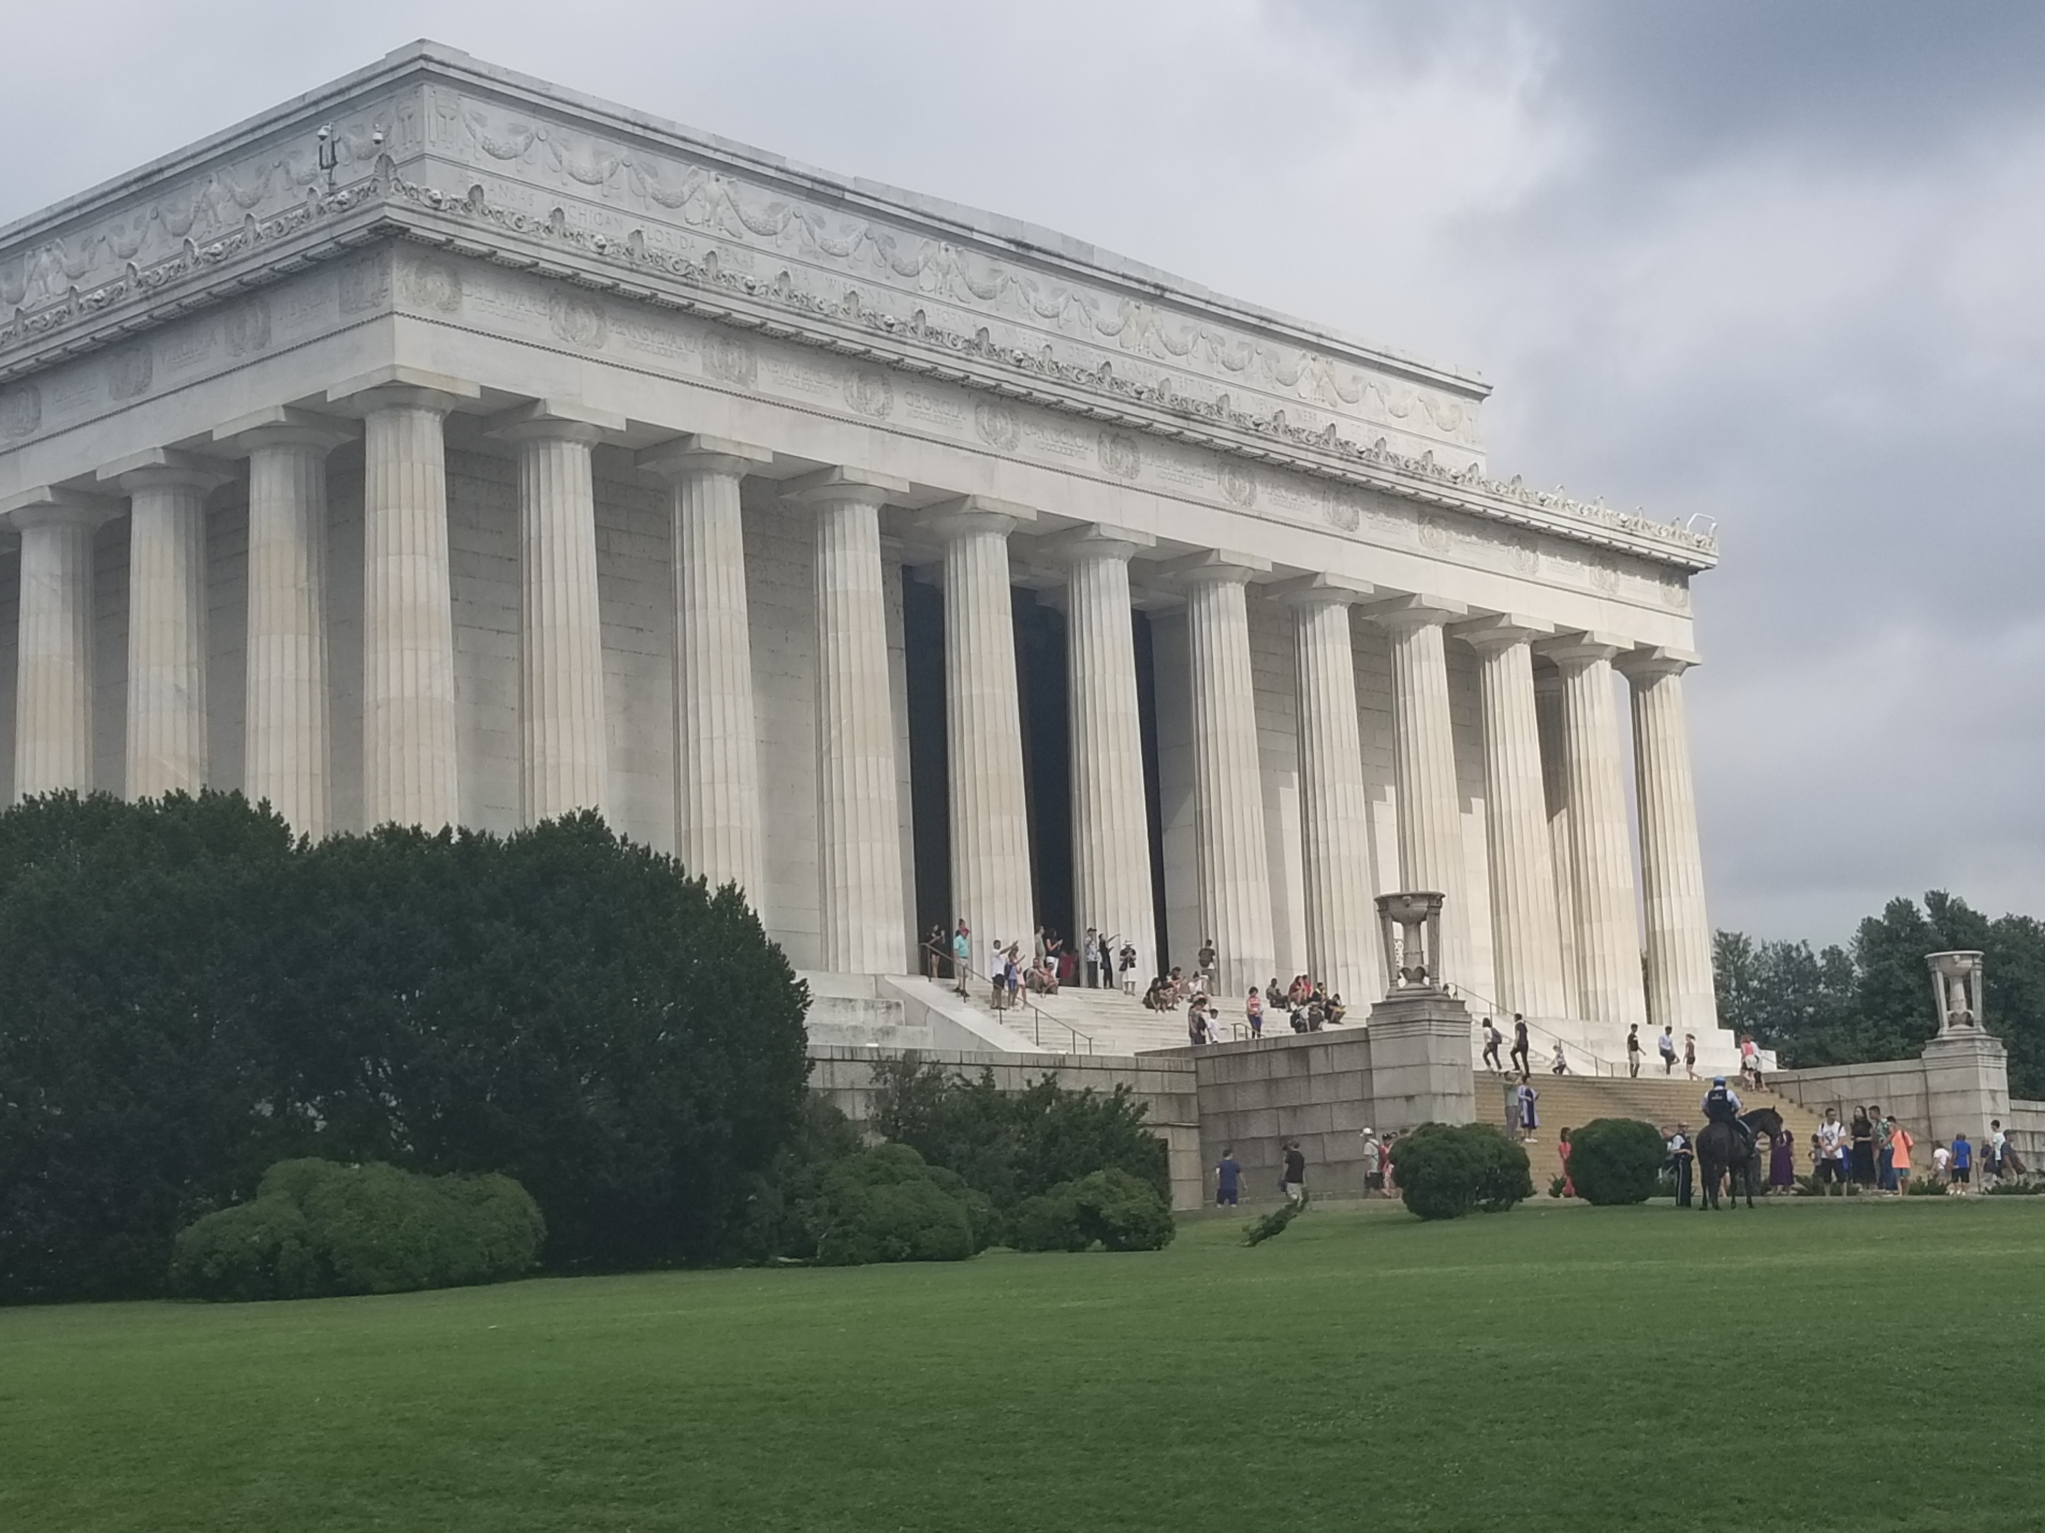
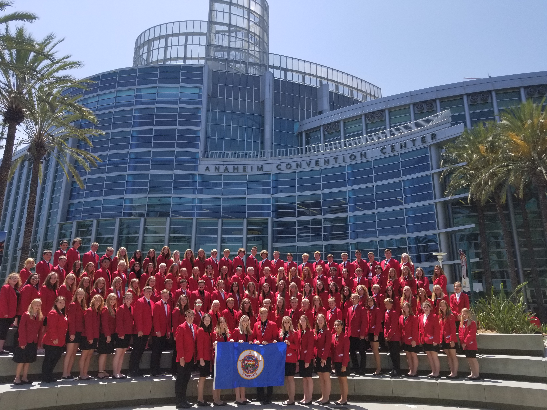
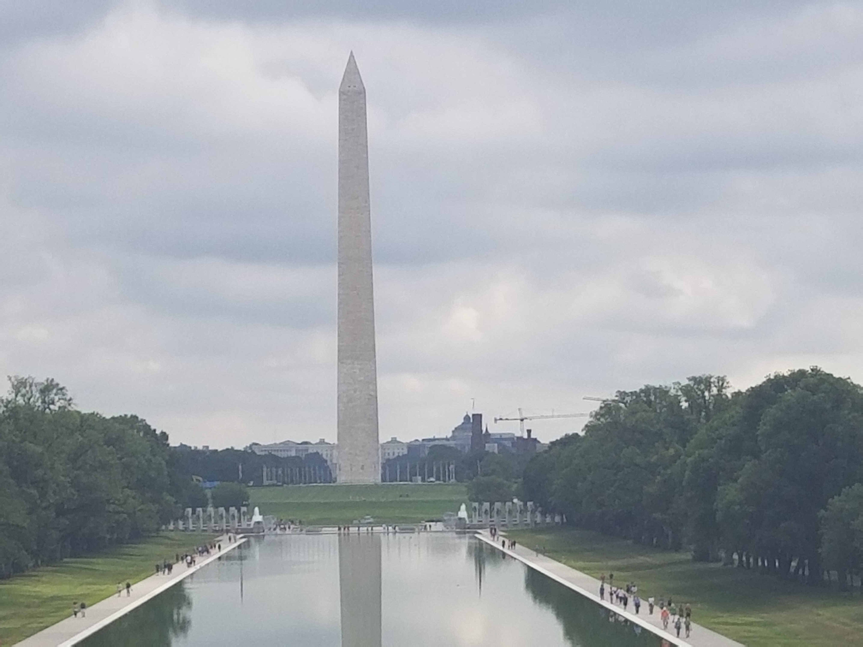
NATIONAL FCCLA CONFERENCE
PLAN NOW TO JOIN THE MINNESOTA DELEGATION to Washington DC in 2020

Slide 22
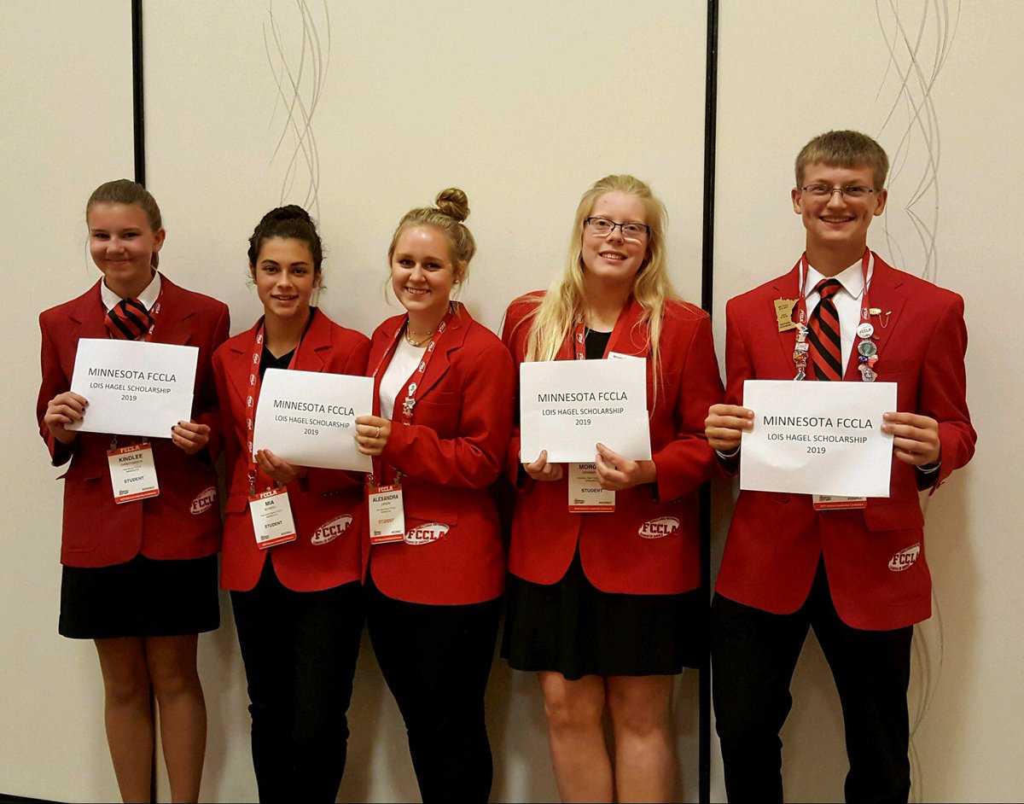
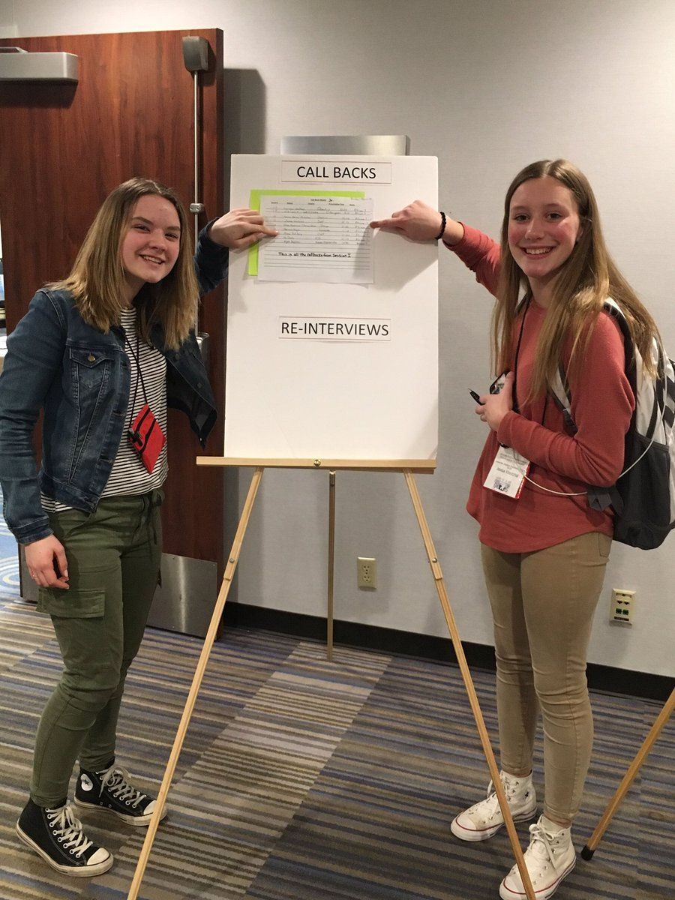
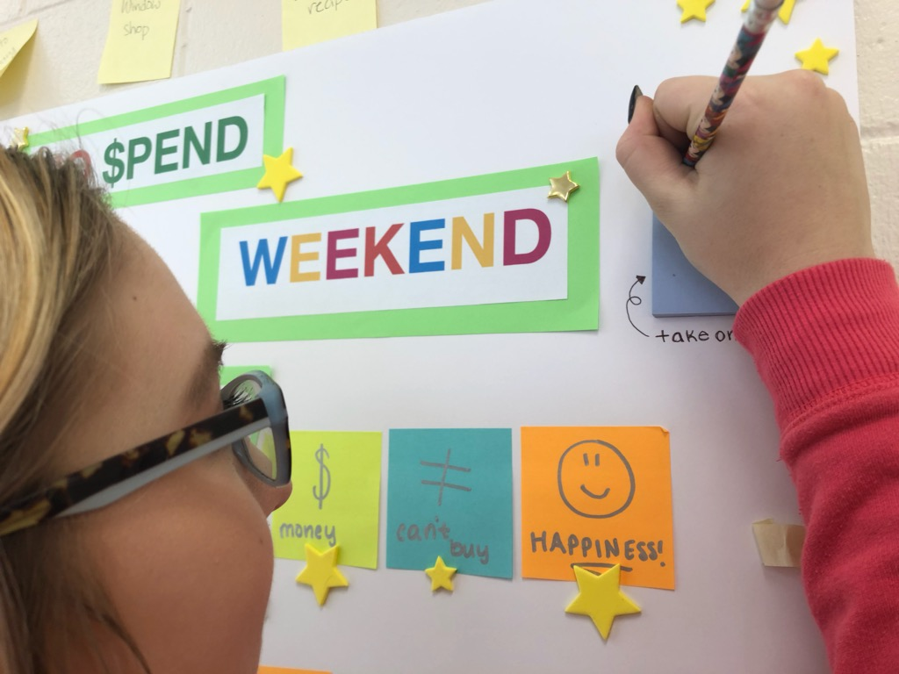
AWARDS
APPLY FOR CHAPTER AWARDS, STATE AWARDS AND NATIONAL AWARDS.
AWARDS RECEIVED AT STATE CONFERENCE OR AT NATIONAL FCCLA CONFERENCE BY MINNESOTA MEMBERS

Slide 23
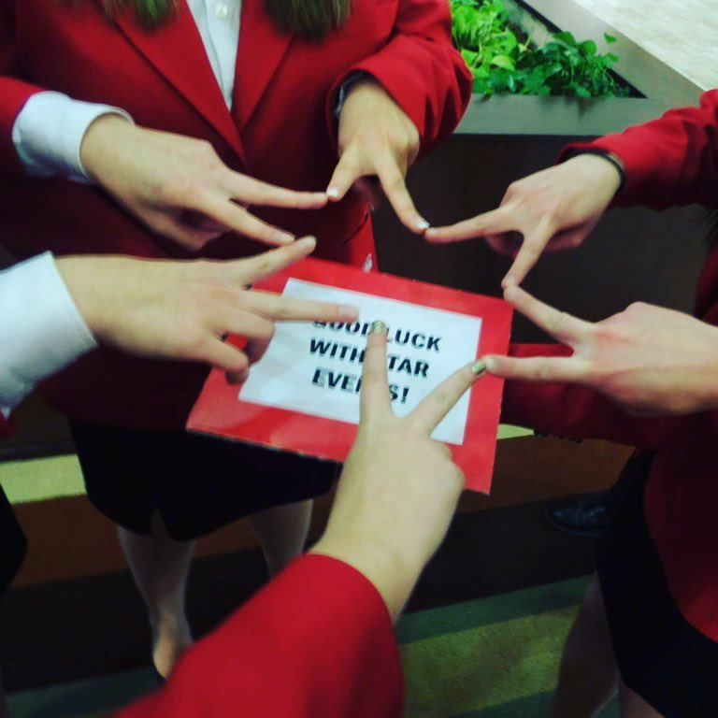
STAR EVENTS RECOGNITION AT AREA, STATE, OR NATIONAL LEVELS
STAR EVENT RECOGNITION

Slide 24
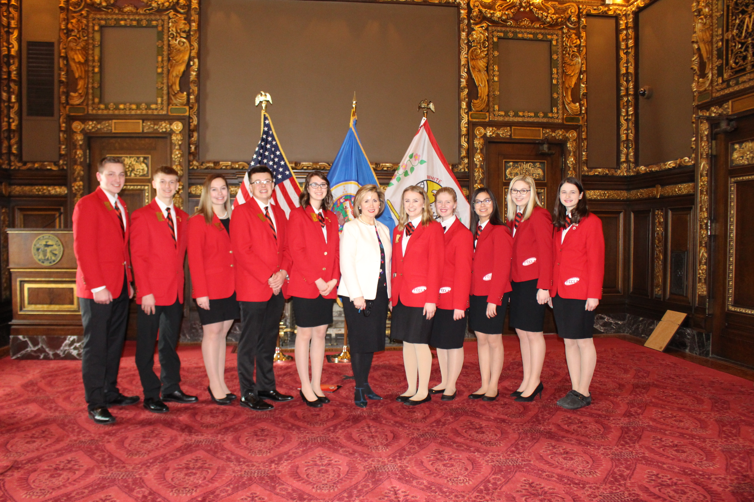
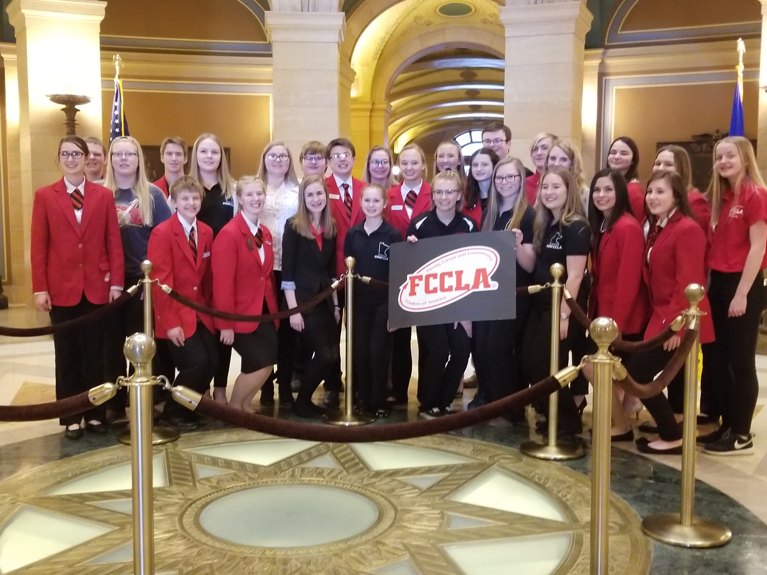
SHADOW DAY
BE PART OF THE SHADOW DAY 2020 IN FEBRUARY!

Slide 25
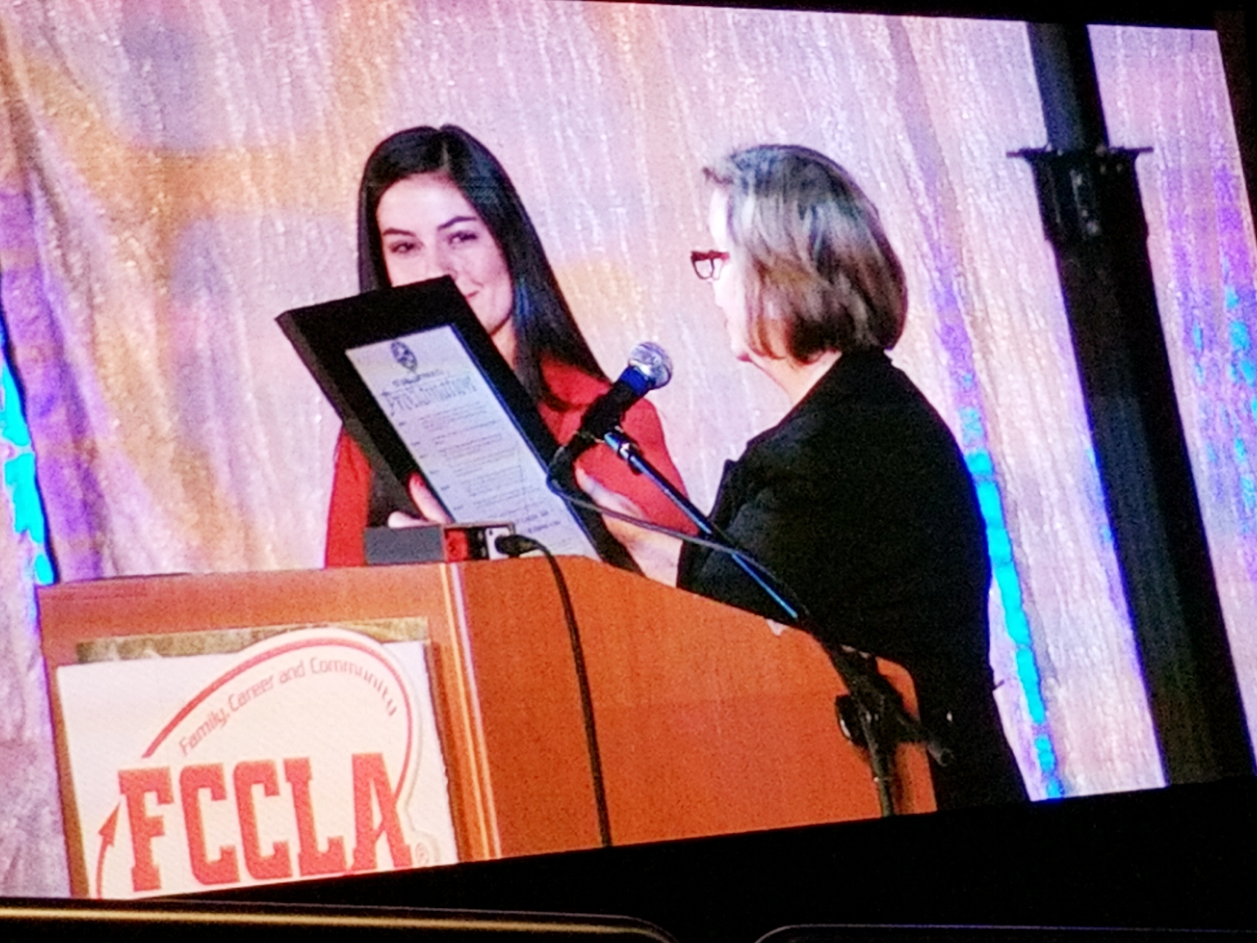
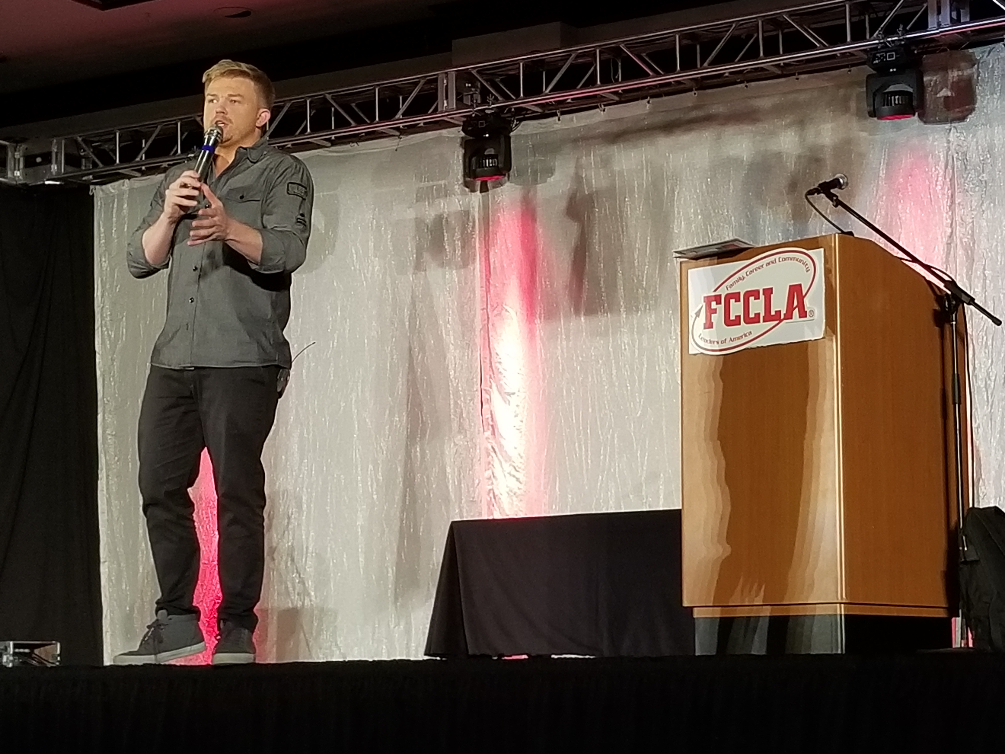
STATE FCCLA CONFERENCE
STATE CONFERENCE 2020 WILL BE MARCH 26-28, 2020.

Slide 26
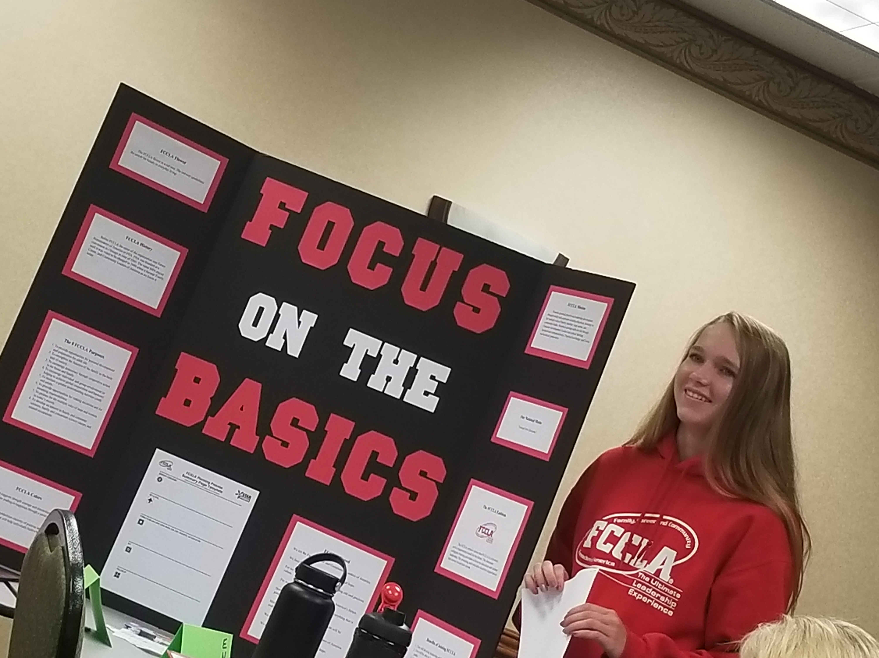
OFFICER CANDIDATES!
Improve your leadership skills!
BECOME A CANDIDATE FOR OFFICER POSITIONS IN 2020!

Slide 27
We are the Family, Career and Community Leaders of America. We face the future with warm courage and high hope. For we have the clear consciousness of seeking old and precious values. For we are the builders of homes, Homes for America’s future, Homes where living will be the expression of everything that is good and fair, Homes where truth and love and security and faith will be realities, not dreams. We are the Family, Career and Community Leaders of America. We face the future with warm courage and high hope.
CLOSING CEREMONY

Slide 28
THANKS FOR COMING!
See you at the next FCCLA event!

