Slide 1
2018 MIDWINTER AREA CONFERENCE
MINNESOTA FCCLA

Slide 2
Welcome to the Area Mid Winter Meeting
The opening session is about to begin. Please take your seats.

Slide 3
To Leadership and Beyond…
STAR EVENTS

Slide 4
To Leadership and Beyond…
Fly to National FCCLA Conference in Atlanta

Slide 5
To Leadership and Beyond…
FCCLA
FCCLA IS A LAUNCHING PAD
FOR YOUR LEADERSHIP EXPERIENCES

Slide 6
To Leadership and Beyond…
Do Projects with a local or global perspective

Slide 7
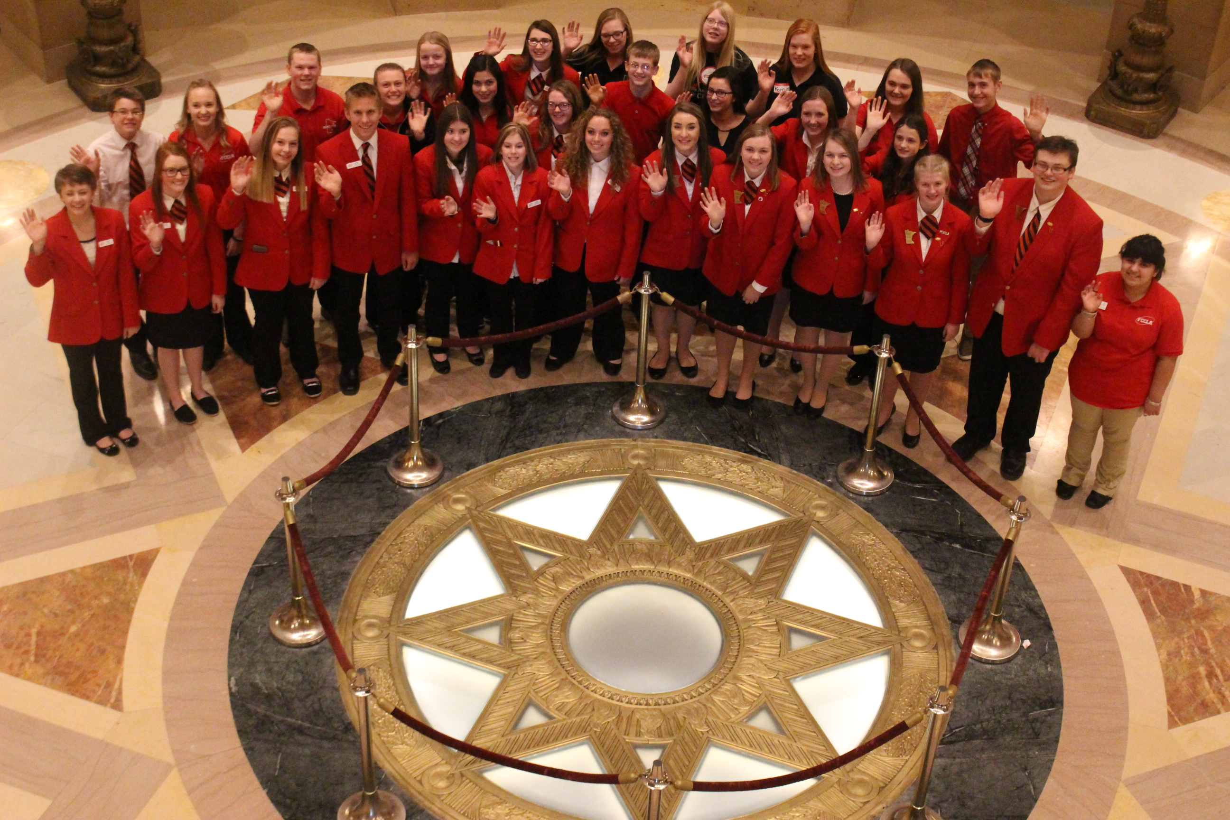
To Leadership and Beyond…
MN FCCLA SHADOW DAY- March 7

Slide 8
2018 MN FCCLA State Theme

Slide 9
PLEDGE OF ALLEGIANCE
"I pledge allegiance to the flag of the United States of America, and to the republic for which it stands, one nation under God, indivisible, with liberty and justice for all."

Slide 10
FCCLA OPENING CEREMONY
President: (Please stand)
We are the Minnesota Family, Career and Community Leaders of America. Our mission is to promote personal growth and leadership development through Family and Consumer Sciences Education.

Slide 11
Officers:
Focusing on the multiple roles of family member, wage earner and community leaders, members develop skills for life through character development, creative and critical thinking, interpersonal communication, practical knowledge and career preparation.
Members: As we work toward the accomplishments of our goals, we learn cooperation, take responsibility, develop leadership and give service.

Slide 12
FCCLA Creed
We are the Family, Career and Community Leaders of America.
We face the future with warm courage and high hope.
For we have the clear consciousness of seeking old and precious values.
For we are the builders of homes, homes for America’s future.
Homes where living will be the expression of everything that is good and fair.
Homes where truth and love and security and faith will be realities not dreams.
We are the Family, Career and Community Leaders of America.
We face the future with warm courage and high hope.

Slide 13
CHAPTER ROLL CALL

Slide 14
GOOD LUCK IN STAR EVENTS

Slide 15
2018 State Conference –AWESOME SpeakerS

Slide 16
MN FCCLA IS A 2018 LEAD STATE AGENCY FOR GLOBAL YOUTH SERVICE DAY
From Martin Luther King Day to State Conference….
Do a Service Project and enter the State Conference Service Parade
2018

Slide 17
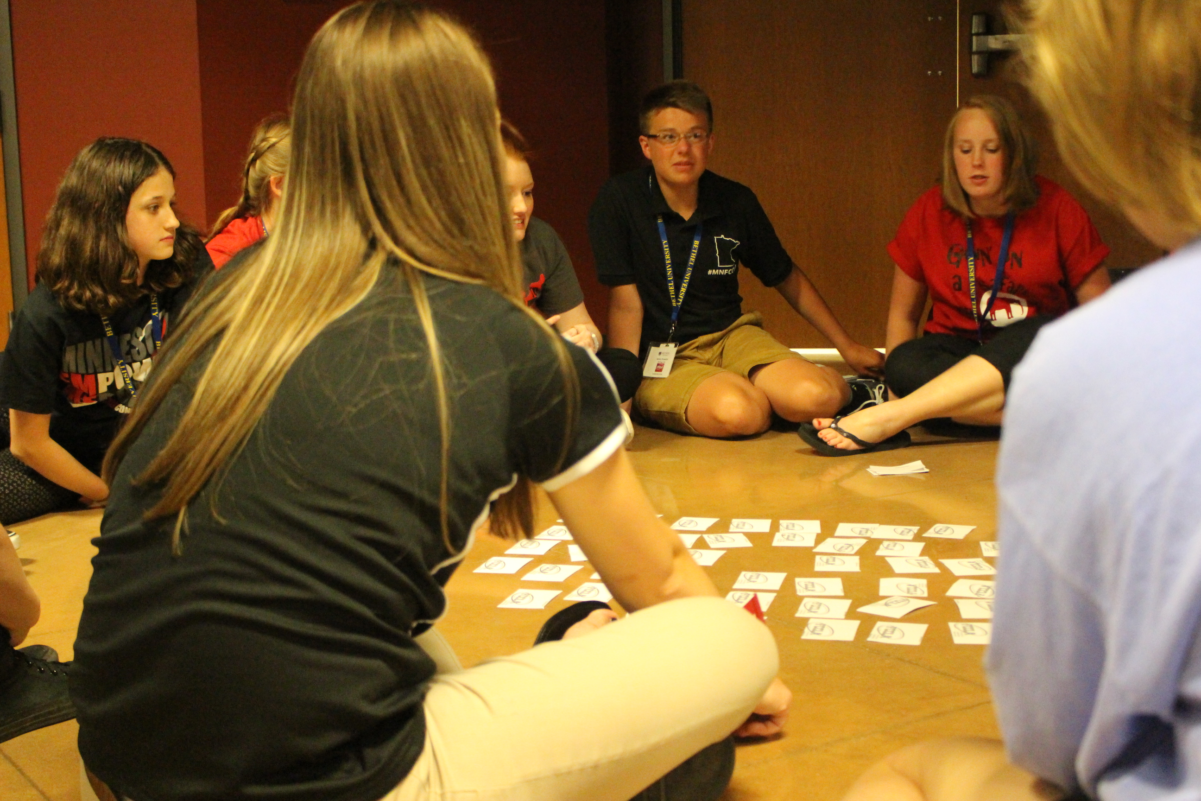
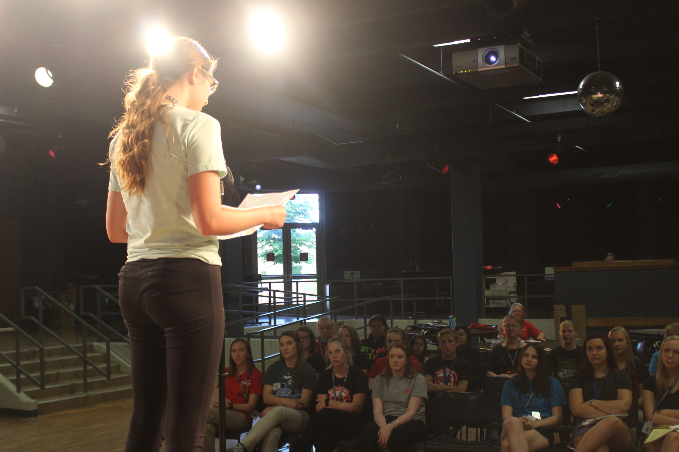
BE A PART OF FCCLA LEADERSHIP CAMP IN JUNE

Slide 18
MEMBERSHIP INCENTIVE
Increase your chapter membership from last year’s number.
7 Up party at State Conference for qualifying chapters.

Slide 19
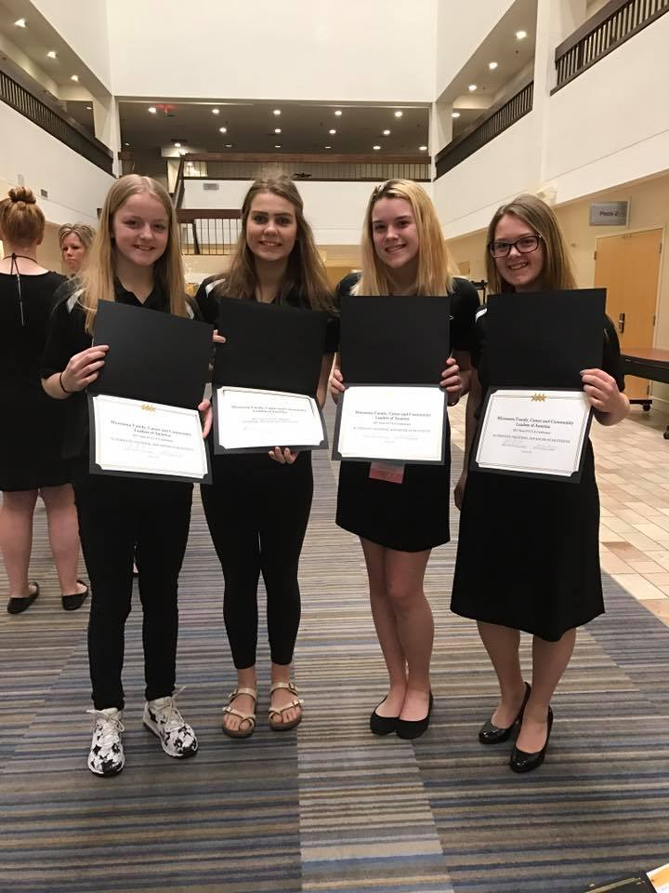
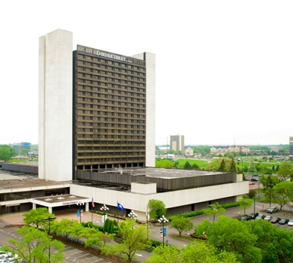
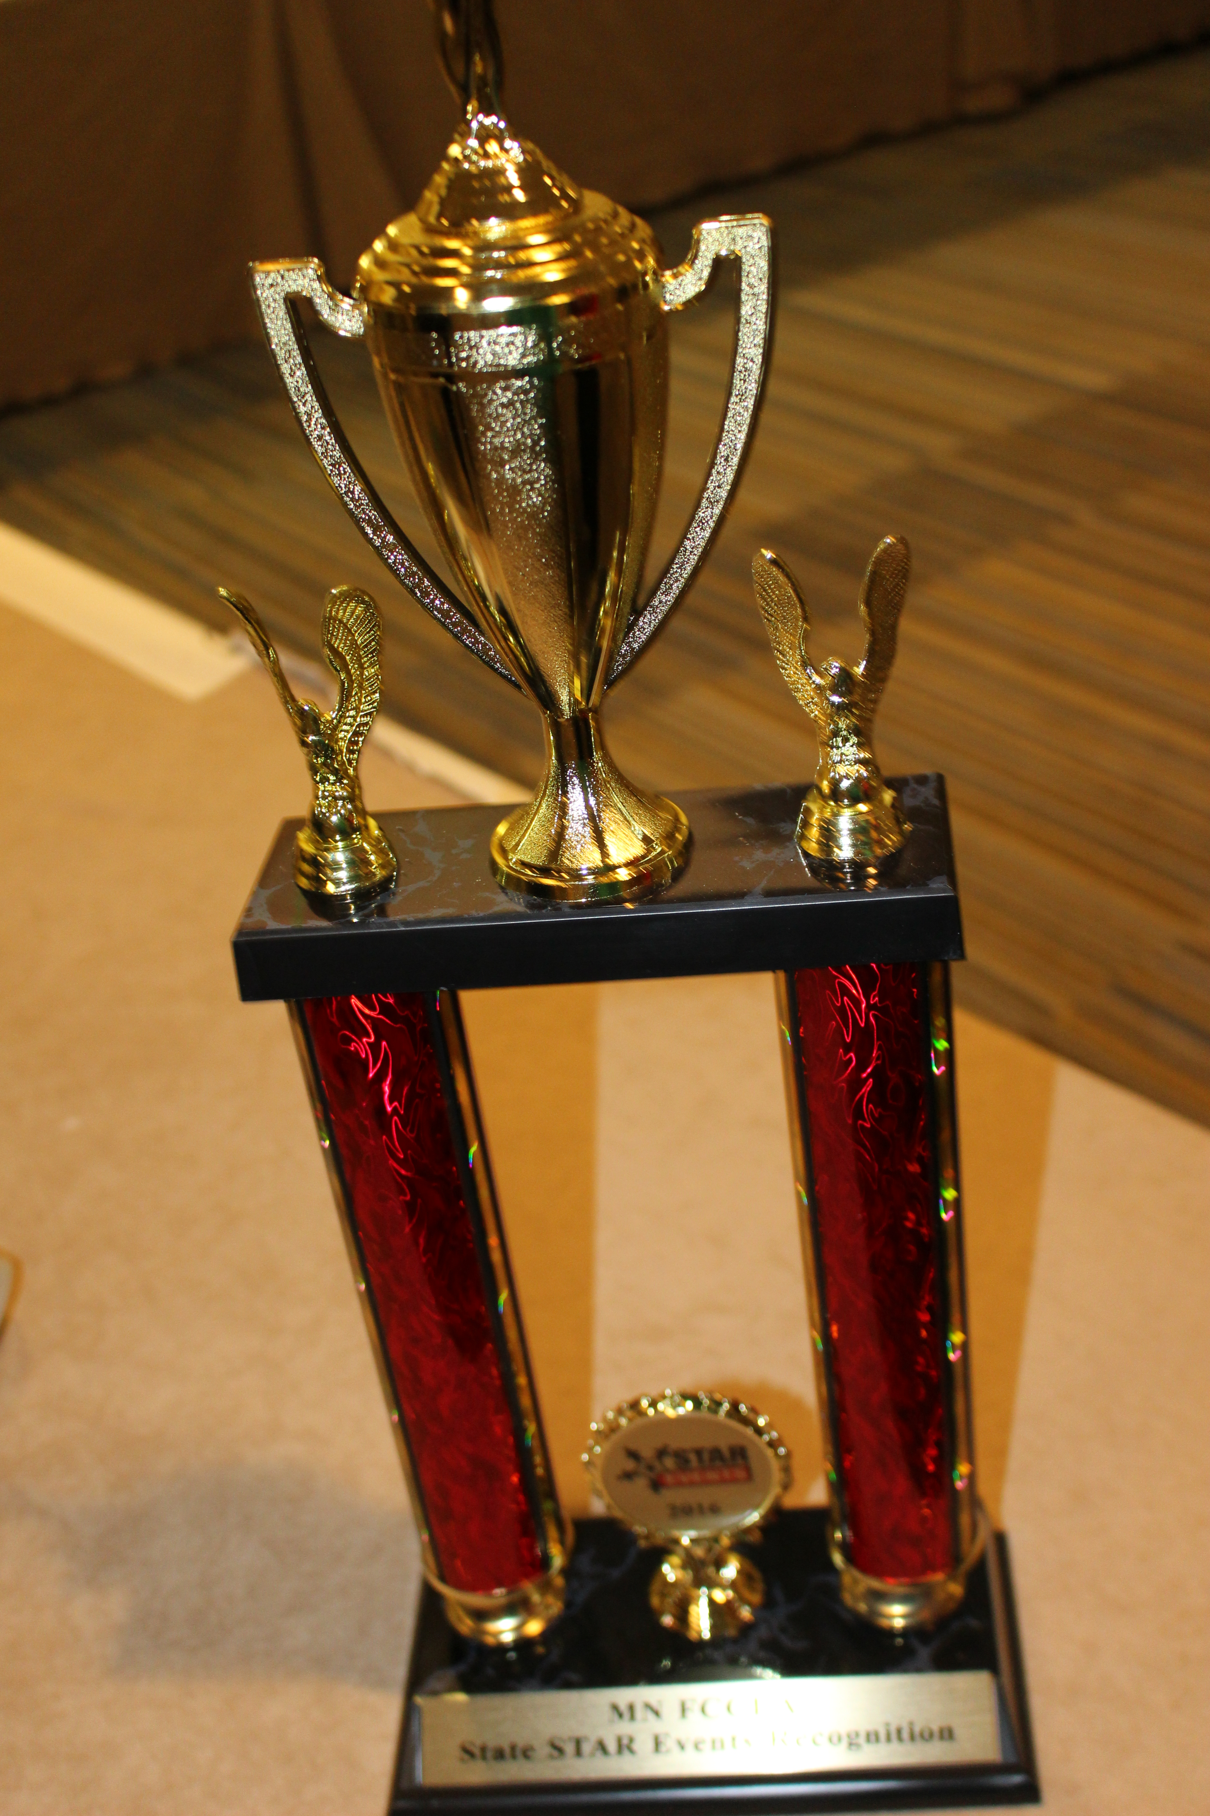
State FCCLA Conference
Bloomington, MN
April 19-21, 2018

Slide 20
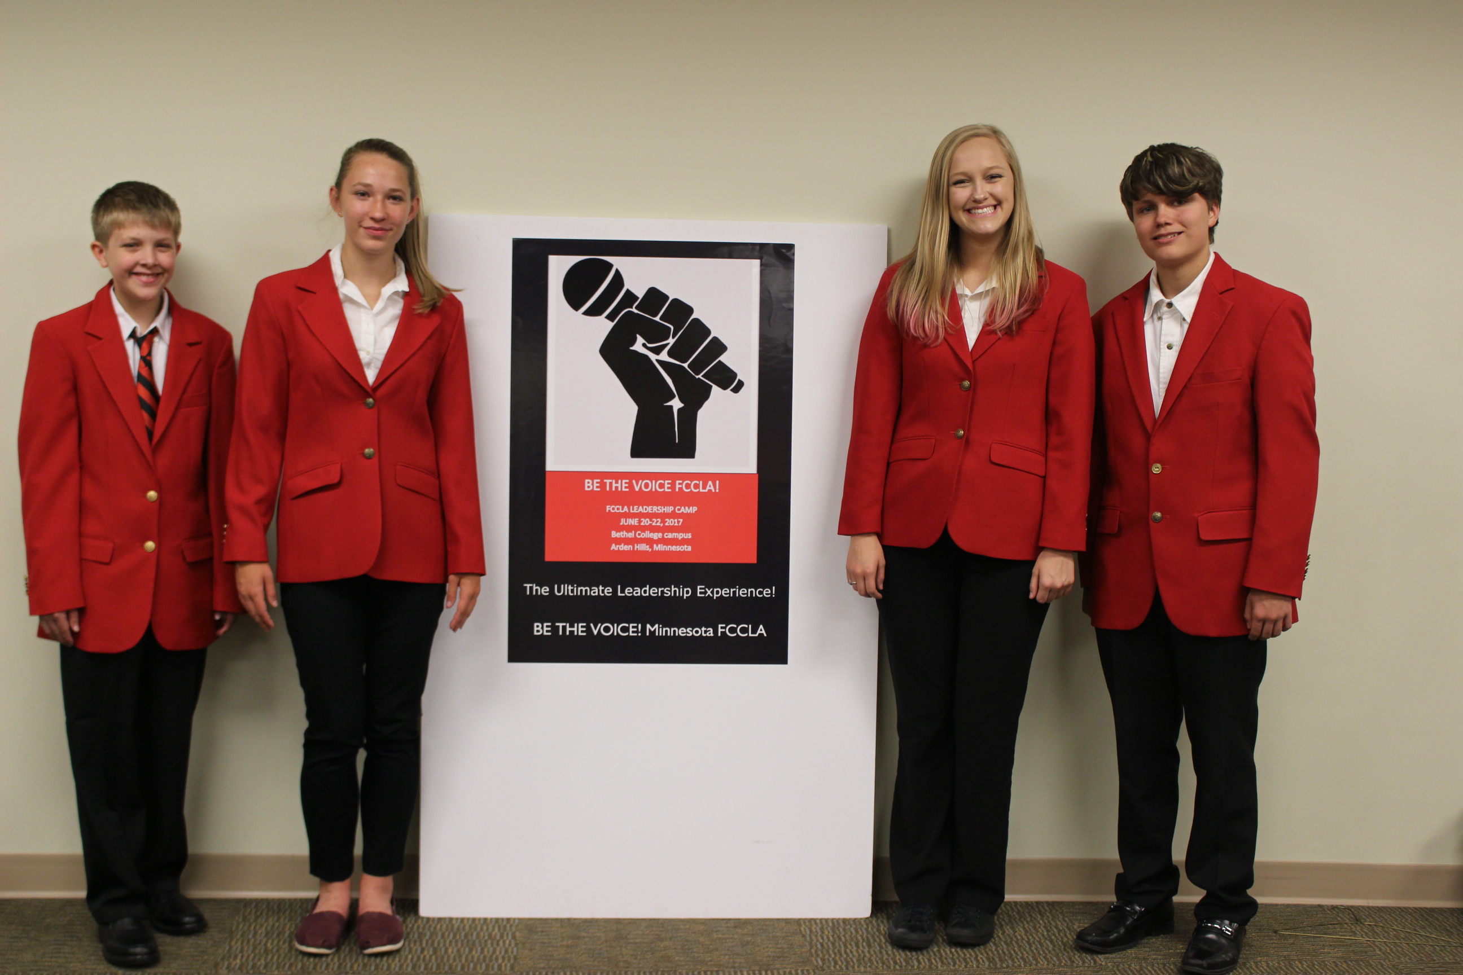
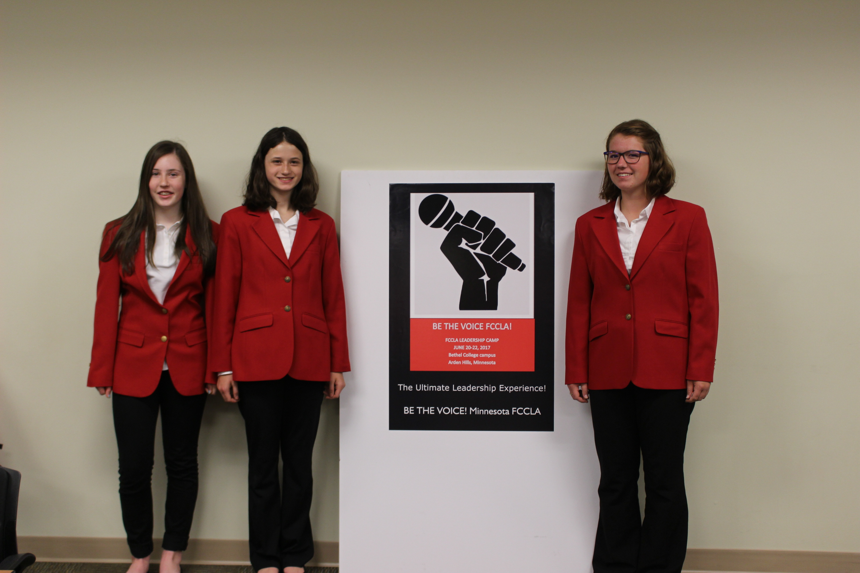
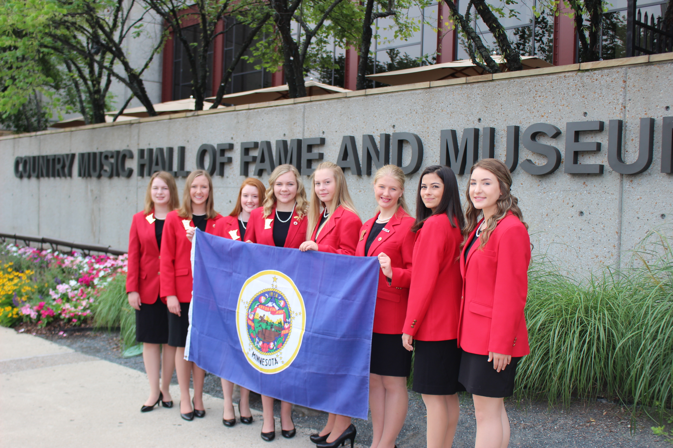
Consider BEING AN OFFICER CANDIDATE
Apply to be a candidate for Officer.

Slide 21
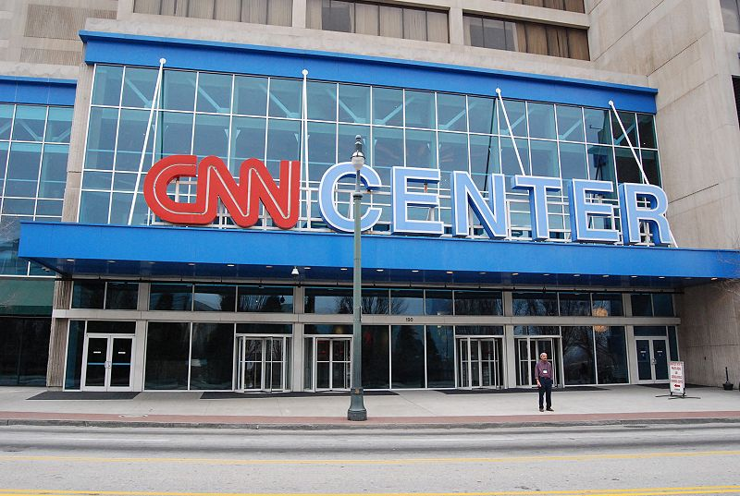
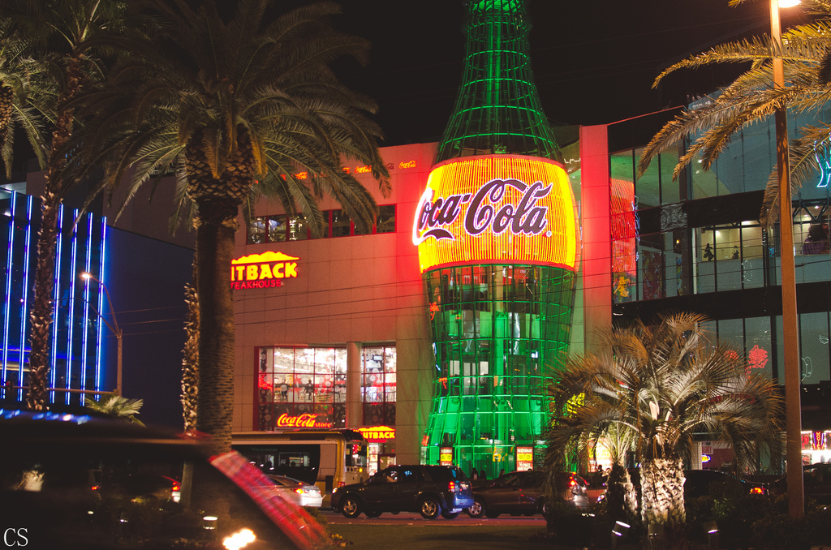
NATIONAL FCCLA CONFERENCE ATLANTA, GA

Slide 22
Talent and Dance Showcase AND FITNESS ACTIVITIES AT STATE CONFERENCE
Enter the Lipsync showcase at State Conference.
Participate in Fitness Events at State Conference Enter SKILL Events at State Conference.

Slide 23
ANNOUNCEMENTS
STATE FCCLA CONFERENCE APRIL 19-21
SHADOW DAY MARCH 7
LEADERSHIP CAMP IN JUNE
NATIONAL CONFERENCE IN JUNE/ JULY IN ATLANTA
GOOD LUCK!

